Slide 1
Wake Transit Plan:
Work Plan and Bus Plan
February 2023
Notes:
Good morning! I am xxxx.
Today, I’ll be giving you an overview of the Draft Work Plan and the Wake Bus Plan.

Slide 2
Agenda
1
Wake Transit Plan Overview
2
Annual Work Plan
3
Wake Bus Plan
Notes:
During today’s meeting, I’ll provide you with some background context about the many plans that are developed within Wake County to define transit service expansion. I’ll begin by giving an overview of the Wake Transit Plan, talk about the draft fiscal year 2024 work plan, and finally talk about the Wake Bus Plan.

Slide 3
Overview
1

Slide 4
Wake Transit Plan
Overview
In 2016, Wake County voters approved a tax package to invest in public transit. Investments in public transit were designed around four big moves:
Connect Regionally
Connect All Wake County Communities
Invest in Frequent, Reliable Urban Mobility
Enhance Access to Transit
The investment program is the Wake Transit Plan.
Notes:
In 2016, voters in Wake County approved a tax package to invest $2.3 billion in public transit services. This investment program is known as the Wake Transit Plan. The bus services included in the Wake Bus Plan support each of the FOUR BIG MODES identified in the Wake Transit Plan and listed here on the screen.

Slide 5
Wake Transit Plan
Overview
Today’s presentation is about two parts of the Wake Transit Plan
FY24 Wake Transit Work Plan
Wake Transit Plan projects scheduled for investment between July 1 2023, and June 30 2024 (FY24).
Includes all Wake Transit Plan projects, including bus projects, but also administration, investments related to Bus Rapid Transit, and Commuter Rail.
Wake Bus Plan
Projects related to bus service and capital improvements.
Focus is on July 1 2024 through and June 30 2027 (FY25 – FY27).
Also includes projects scheduled between July 1, 2027 and June 30, 2030 (FY28 – FY30).
Notes:
While the Wake Transit Plan addresses large infrastructure projects such as commuter rail and bus rapid transit, the focus of today’s presentation is on two plans that are currently out for public comment through March 22nd.
The first is the Draft Fiscal Year 2024 Wake Transit Work Plan. This is a document that describes all of the transit projects that are scheduled for funding during the upcoming year. I will briefly discuss this plan today because the Work Plan and Bus Plan are conducting a coordinated public engagement effort
The Wake Bus Plan is a document that focuses on bus service improvements that are recommended for Wake County between 2025 and 2030. It will build on the bus service expansion projects that have been implemented since 2018 and that are included in the draft 2024 work plan. The Wake Bus Plan provides detailed information about projects to be implemented starting in 2025 through 2027. These are bundled into short range transit plans for each implementing agency. It also defines operating and capital projects for the later years of the WTP 2028-2030.

Slide 6
Wake Transit Work Plan
2

Slide 7
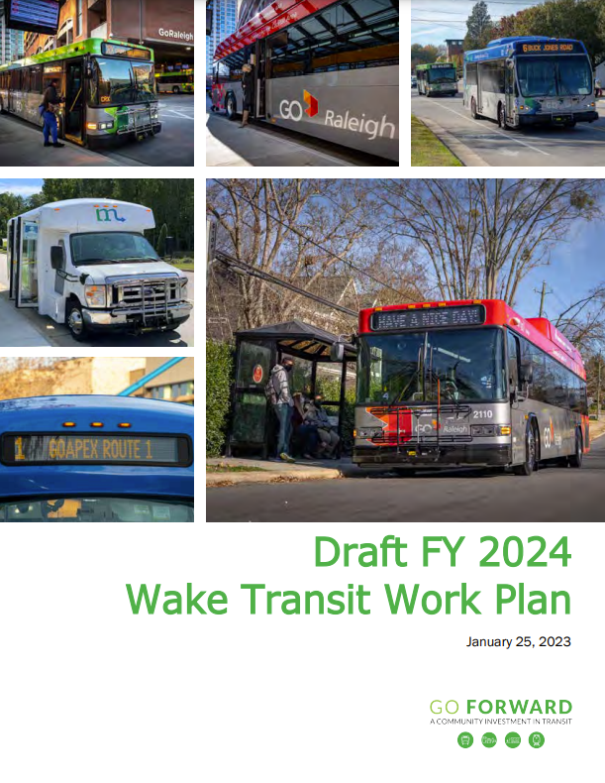
Wake Transit Work Plan
Overview of the Work Plan
What’s included
How to read it
Highlights of plan for FY 2024
Notes:
The following slides show you two things:
An overview of what is included in the Work Plan and how to read it
Quick summary of some of the projects programmed for implementation in FY24

Slide 8
Transit Work Plan: Elements
Wake Transit Work Plan
FY24 Operating Budget
FY24 Capital Budget
Financial Model Assumptions
Also includes
Multi-Year Operating Program
Capital Improvement Plan

Slide 9
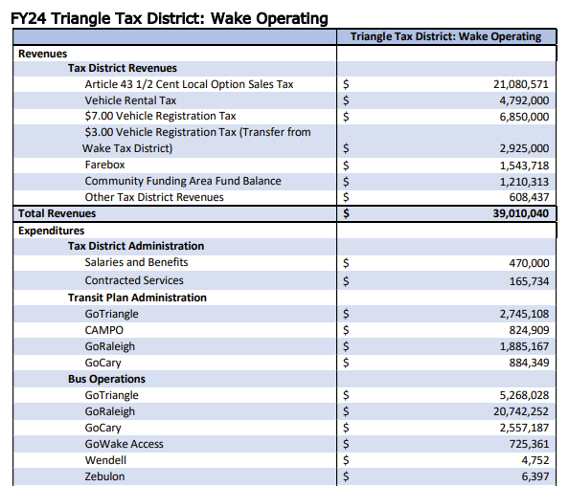
Transit Work Plan: Highlights
Wake Transit Work Plan
Shows the available funding and how funds will be spent.
Funds (or revenues) by source
Expenditures or spending plan
Notes:
Both the Operating budget and Capital budget sections begin with a Budget Summary Page that reflects expenditures for new investments proposed to be funded in FY24.
This is an example of the operating budget summary page. You can see the Revenues & Expenditures by category – as well as an additional subcategory for project sponsor.

Slide 10
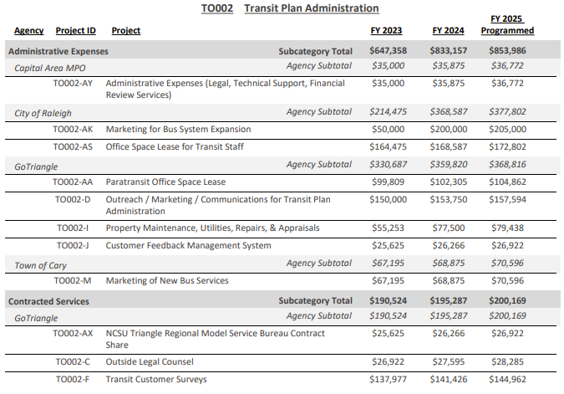
Transit Work Plan: Project Summaries
Wake Transit Work Plan
Spending Category
Role of Each Agency (or Project Sponsor)
Specific projects (or responsibility)
Notes:
Next we have the Project Summary Sheets – we have these also for both Operating and Capital and they include subcategory expenditures by project sponsor as well as an additional detail for each project sponsor where the implementation elements, or actual projects, are listed.

Slide 11
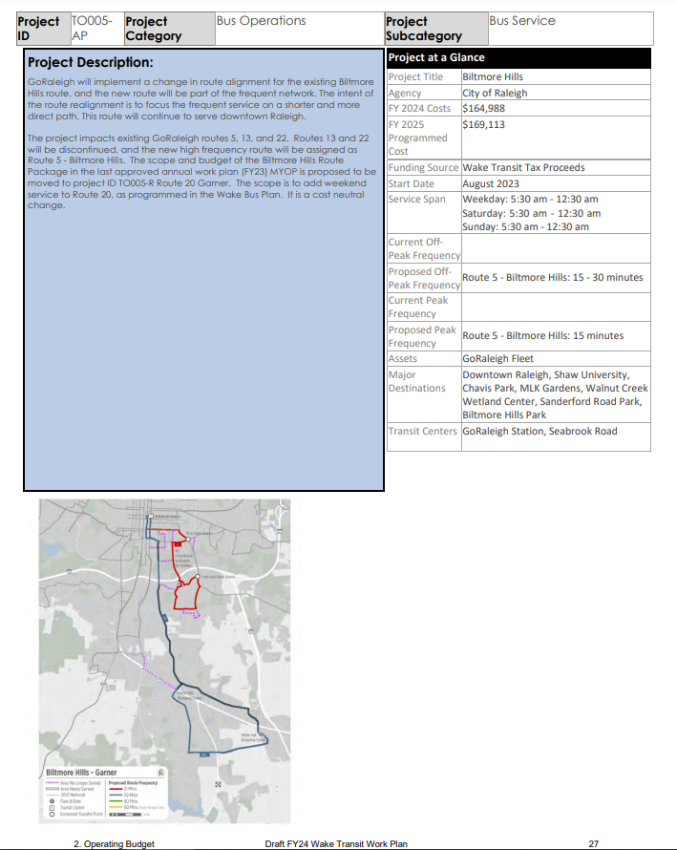
Transit Work Plan: Projects
Wake Transit Work Plan
Project Summary
Project title
Detailed description
Sponsor
Cost
Start date
Notes:
Next we have the Project Summary Sheets – we have these also for both Operating and Capital and they include subcategory expenditures by project sponsor as well as an additional detail for each project sponsor where the implementation elements, or actual projects, are listed.

Slide 12
Operating Program Highlights
Wake Transit Work Plan
Plan spends most funding (82% or $31.9 million) on continuing existing services.
Increased frequency on GoRaleigh Route 5 (Biltmore Hills)
Increase frequency/longer hours on GoTriangle Route 100 (Raleigh-Durham) & Route 300 (Cary-Raleigh)
Increase frequency/ operate all day on GoTriangle Route 305 (Holly Springs-Apex-Raleigh)
Increase Sunday service on select GoRaleigh and GoCary routes
Increase mid-day service on select GoCary routes
Support GoWake Access Rural, Elderly and Disabled service (countywide)
Continue Wake Transit Community Funding Area Program (Apex, Morrisville and Wake Forest) and add new projects
Notes:
The Draft FY24 Work Plan allocates $39 million to the Wake Operating Budget.
$31.9 million would be designated for the continuation of services that were funded in previous years.
Some highlights of what is included in the operating budget are… (READ SLIDE)

Slide 13
Capital Program Highlights
Wake Transit Work Plan
The Draft FY24 Work Plan capital program is $203.8 million with about 42% from federal sources. Program highlights include:
New shared GoRaleigh Access and GoWake Access paratransit operations and maintenance facility
Replace GoCary Operations Center
Wake County’s share of GoTriangle’s bus operations and maintenance facility
Design and construction of new bus stops and improved passenger facilities
Improvements to GoTriangle’s park-and-ride facilities
Develop new Regional Transit Center.
Technology upgrades and updates to support system-wide activities
Notes:
The Draft FY24 Work Plan then allocates $203.8 million to the Wake Capital Budget. $85.9 million of the total comes from federal funding allocated for the Wake BRT: Southern Corridor, and $19 million was allocated from the Wake Capital Fund balance for future projects.
Some highlights of what is included in the capital budget are… (READ SLIDE)

Slide 14
Wake Bus Plan
2

Slide 15
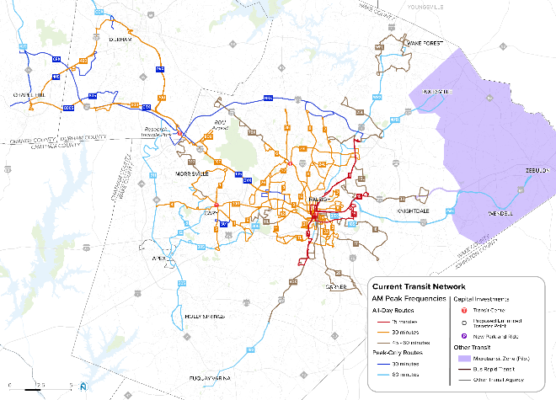
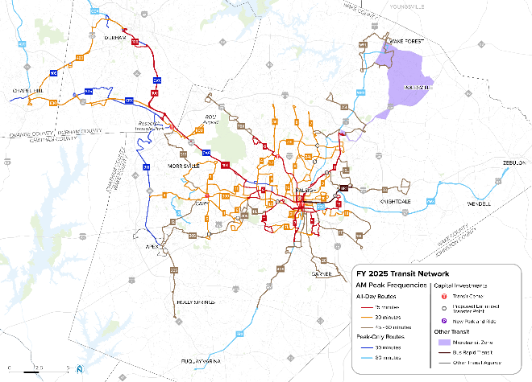
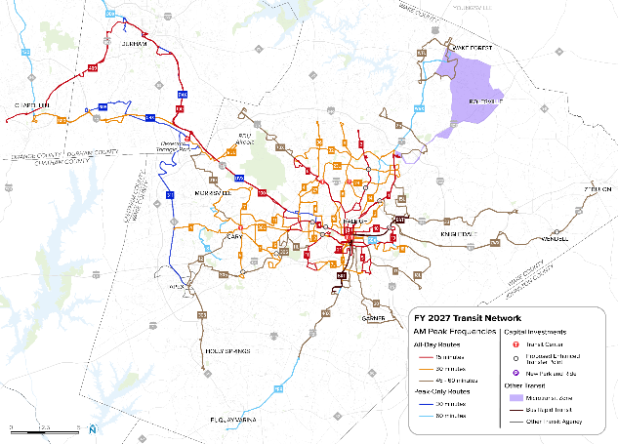
Wake Bus Plan
Wake Bus Plan
Overview of the Bus Plan
What it is and how it was prepared
What’s included in the plan
Key Themes and Recommendations
Wake Bus Plan Outcomes
Notes:
I also want to share the Wake Bus Plan with you – namely – what it is and how it was prepared and how it will change transit in Wake County.

Slide 16
What is the Wake Bus Plan?
Overview
The Wake Bus Plan is a year-by-year investment schedule for bus projects included in the Wake Transit Plan. It includes:
Bus service or operating projects
Introduce new bus routes or bus services
Increase the frequency of bus routes
Extend the hours of operations
Capital projects.
Passenger facilities (new bus stops, transit centers, etc.)
Vehicles (buses and vans)
Vehicle maintenance facilities
Focus is on 2024 – 2027 but includes projects planned until 2030.
Notes:
The Wake Bus Plan Update is part of the Wake Transit Plan. It is a year-by-year plan for how taxpayer money will be spent to improve bus services. The Wake Bus Plan includes investments in bus service and capital projects.

Slide 17
Creating the Draft Wake Bus Plan
Overview
Bus Plan combines data and community/stakeholder input:
Data inputs:
Analysis of transit markets and needs
Assessment of gaps between existing services and needs
Evaluation of existing bus services
Notes:
We also used a combination of data and feedback from riders to prioritize which projects would be implemented first. The data inputs included information about transit markets – places were there are more people and jobs and more densely developed places. We also considered how well these places are served today and if additional connections were needed.
Our analysis also considered existing ridership on the bus routes – where bus routes are doing well and carrying a lot of riders and might need additional investments and bus routes that aren’t performing well. We considered if these bus routes need more investments or a different way of operating and providing service.
We also looked at how we can improve service for the greatest number of people and historically disadvantaged communities.

Slide 18
Creating the Draft Wake Bus Plan
Overview
Bus Plan combines data and community/stakeholder input:
Community/stakeholder engagement
Collected feedback on locations and types of accessibility improvements
Needs for investments like sidewalks, crosswalks, bike lanes, etc.
Conducted in Fall 2021
Shared draft service improvement ideas
Ideas for new bus routes and new service types
Conducted in Spring 2022
Current input on recommended improvements and timing
Ongoing (Winter 2023)
Notes:
This is the third time we are asking members of the public for input to the Wake Bus Plan.
The first round was in the Fall of 2021, when we asked for ideas about where we need more investments in things that will make it easier to get to/from transit services. This means investments in projects like sidewalks, crosswalks, and bike lanes.
The second round was in the Spring 2022, when we held pop-up events to talk with people about the types of bus service improvements they wanted to see. Information provided through this process helped us design bus services and prioritize projects.
The third round – conducted right now – shares our draft recommendations for year-by-year investments in bus services.

Slide 19
Where are we in the process?
Overview
Market Assessment
Prioritization of projects
Recommended Wake Bus Plan and Short Range Transit Plans
Project Concepts
Programming of projects
Final Wake Bus Plan
We are Here
Public Engagement
April-May 2022
Public Engagement
Feb-Mar 2023
Notes:
Work completed to date has been ongoing since July 2021 when we held our project kick off meeting with the consulting team Nelson\Nygaard.
We’ve held working group meetings once a month with staff from partner transit agencies, municipalities, the county, and metropolitan planning organization. The purpose of these working group meetings were to provide guidance to the project team in developing the plan materials.
We’ve held
15 technical and stakeholder meetings
10 engagement team meetings
As well as several drop-in sessions and other meetings between the project team and transit providers to further refine project concepts.
Public engagement was done in Spring 2022 once the project concepts were defined.
Following that engagement effort, we held two workshops in 2022 to finalize the route concepts that are the recommended Wake Bus Plan. We worked collaboratively with the working group to determine the priority order for projects to receive Wake Transit funding, and then to program them within the financial constraints of the Wake Transit Plan.
Following the engagement effort, we will refine the plan and bring back the final plan to the TPAC and the governing boards.

Slide 20
Invest in Frequency
Themes and recommendations
Frequent bus routes performed well, even during COVID.
Bus Plan looked to areas where increasing service levels – especially more frequent service – would better serve people and attract more riders.
Examples of frequent service investments:
GoRaleigh Route 5 Biltmore Hills
GoRaleigh Route 11 Avent Ferry
Go Raleigh Route 3 Glascock
GoRaleigh Rouyte 7L Carolina Pines
GoTriangle Route 305 Holly Springs-Apex-Raleigh

Slide 21
All-Day Service
Themes and recommendations
Community input and changes in travel plans demonstrated a need to operate service all day long and on weekend days.
Bus Plan expanded some services during the middle of the day and on Saturdays and Sundays.
Examples of investments in all day service include:
GoTriangle Route 100 Raleigh-RTC-Durham
GoTraiangle Route ZWX Zebulon-Wendell-Raleigh
GoCary Route 12 ACX
GoRaleigh Route 12 Method

Slide 22
New Service Models
Themes and recommendations
Changes in work schedules and growth in areas that have lower density develop meant the Bus Plan considered new service models, like microtransit.
Examples of new service models:
GoRaleigh North Wake Microtranit (replaces Route 401X Rolesville)

Slide 23
Bus Service Investments
outcomes
Wake Bus Plan will increase bus service in Wake County. Adds roughly 29% more service by 2030. Most new service will be in Raleigh.
Notes:
The Wake Bus Plan service program grows the transit network from approximately 490,000 revenue hours in FY2023 to 630,000 revenue hours in FY2030
The costs to operate this network grows from $55.4 million in FY2023 to $83.8 million in FY2030 (including non-Wake Transit funding sources)

Slide 24
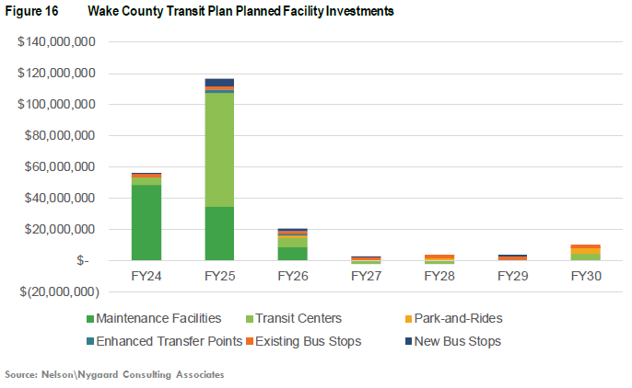
Capital Project Investments
outcomes
Adding service means adding and improving passenger facilities. It also means buying more buses. Plan allocates $292 million to capital projects.
Notes:
The capital projects support the expansion of bus service. The plan includes $292 million through 2030 towards capital projects such as maintenance facilities, transit centers, park and rides, enhanced transfer points, and bus stop improvements.
40% of all capital funding is allocated towards 3 projects in the first few years:
Cary Multimodal Center
GoCary Bus Maintenance Facility
GoRaleigh/GoWake Access Maintenance Facility

Slide 25
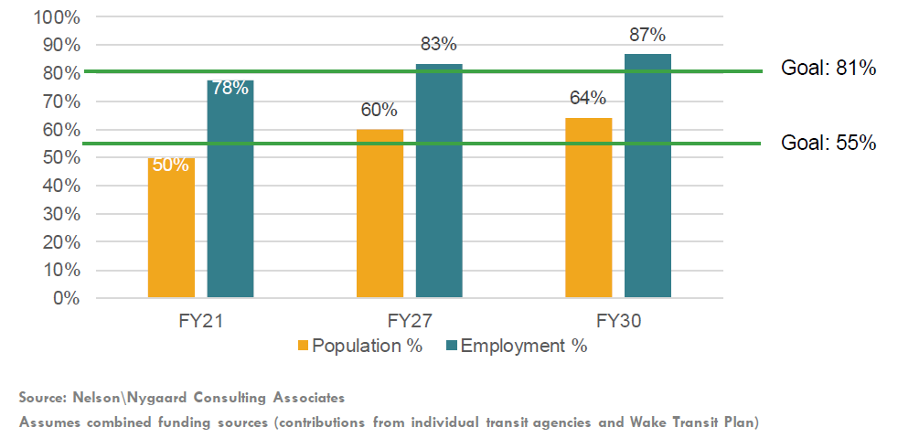
Goal: Expand Access to All-Day Bus Service
Outcomes
The Wake Transit Plan set a goal of ensuring that all-day transit service is accessible to 55% of Wake County residents and 81% of jobs in Wake County.
Includes bus, bus rapid transit, and microtransit services (within ¾ mile of a Smart Shuttle node or within the boundaries of an on-demand microtransit zone)
Notes:
This Wake Bus Plan meets this goal by FY2027, when 60% of residents and 83% of jobs will be within ¾ miles of the proposed all-day transit network.
The program further exceeds this goal in FY2030, with 64% of residents and 87% of jobs within ¾ miles of the all-day network.

Slide 26
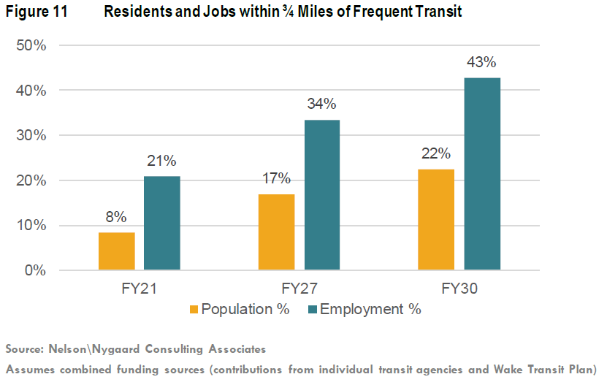
Goal: Expand Access to Frequent Bus Service
Outcomes
Providing frequent and reliable urban mobility is one of the four Big Moves. The Wake Bus Plan increases the percent of residents and jobs in proximity to high frequency transit.
Includes bus and bus rapid transit.
Notes:
By FY2030, 22% of the county’s residents and 43% of jobs will be within ¾ miles of frequent services

Slide 27
Thank You!
Notes:
We will be collecting comments on the recommended Wake Bus Plan through March 22nd.
Following the engagement period, the Wake Bus Plan project team and working groups will review the comments and respond to the comments that were received. The final draft of the 2025-2030 Wake Bus Plan will be prepared by May or June, at which time we will go through the process to bring the plan to the TPAC and eventually the GoTriangle Board and CAMPO Executive Board to consider adoption.

Slide 28
Transit Plans, Bus Plans, and Prioritization
Overview
Wake Transit Plan (2016) Route level planning No prioritization or programming done Public engagement on proposed bus network | Wake Bus Plan and SRTPs (2018) Route level implementation details Prioritization and programming policy created and implemented Public engagement on programmed projects
Wake Transit Plan Update (2020) No route level planning Re-prioritization and programming done on Wake Bus Plan and SRTP projects, given changing financial and market conditions Public engagement on community priorities | Wake Bus Plan and SRTPs Update (present) Route level planning and implementation details Prioritization and programming policy updated and implemented on new planned projects Public engagement on route concepts

